Slide 1
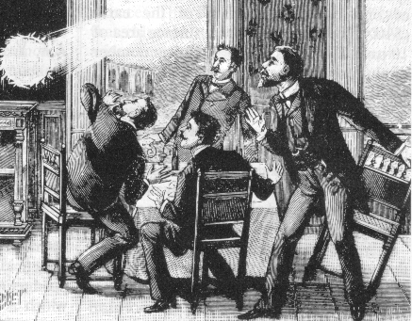
From Switching Arcs to Ball Lightning to Curing Cancer. From Switching Arcs to Ball Lightning to Curing Cancer John. J. Lowke CSIRO Manufacturing, Sydney NSW, Australia

Slide 2
Switching Arcs

Slide 3
RRRV (rate of rise of recovery voltage)
After Current Zero
Determine RRRV,
Maximum Rate of Rise of Recovery
for interruption
Before Current Zero
Specify dI/dT, rate of decrease of current

Slide 4
Air, SF₆ and Pressure
SF₆ is better than Air
Interruption improves with Pressure
Frind and Rich, IEEE Trans. PAS 93, 1675-1684 (1975)

Slide 5
- ℥
Radiation

Slide 6
Electrical Conductivity
Thermal Conductivity
Radiation
Enthalpy Density

Slide 7
Critical RRRV Theory and Experiment
Early Values

Slide 9
+ n_{e}αW
n_{e}αW = Ionization from electric field eg dielectric breakdown
Use σ = n_{e} e W/E in energy balance equation

Slide 10
Evaluating σ
= j/E = n_{e} e W/E = n_{e} e /E × (Ee/mν)
= n_{e} e²/[mc(n_{i} Q_{i} + N Q₀)]
Q_{i} ~ 100 Q₀

Slide 11
Electron Ionization and Attachment
α is ionization coefficient
η is attachment coefficient

Slide 13
Welding Arc

Slide 17
Ball Lightning
Inside of houses and aeroplanes

Slide 18
Ball Lightning
Inside of houses and aeroplanes
Properties
Usually appears from closed glass windows – leaving no trace.
Brightness of a 100W incandescent light bulb.
About the size of an orange.
Lasts about 10 seconds.
Singlet delta oxygen metastables
a¹Δ_{g}
Radiative lifetime ~ 1 hour
Detach electrons from O₂⁻
Energy ~ 1 eV
Excitation Cross Section known
Quenching Lifetime ~ 1 s

Slide 19
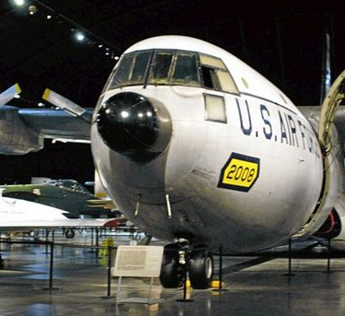
From Don Smith and Wilfried Heil

Slide 21
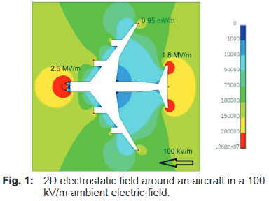

Slide 22
Ionization and Attachment Coefficients in Air at 1 bar.

Slide 23
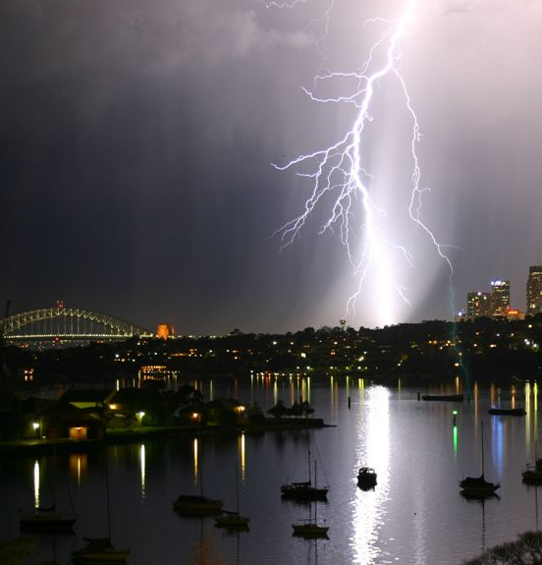
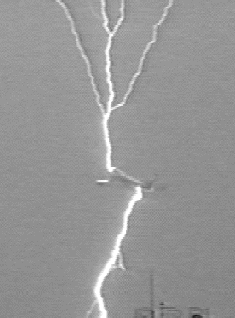

Slide 24
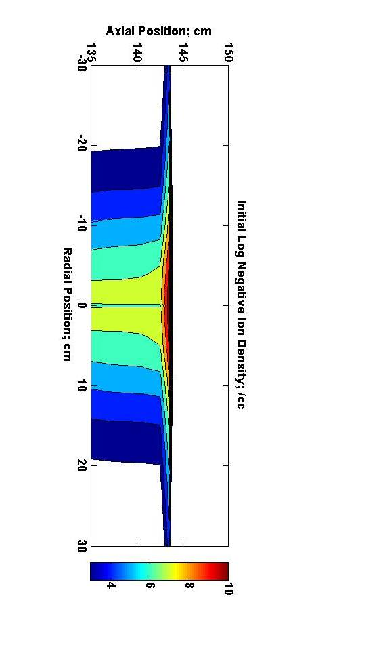
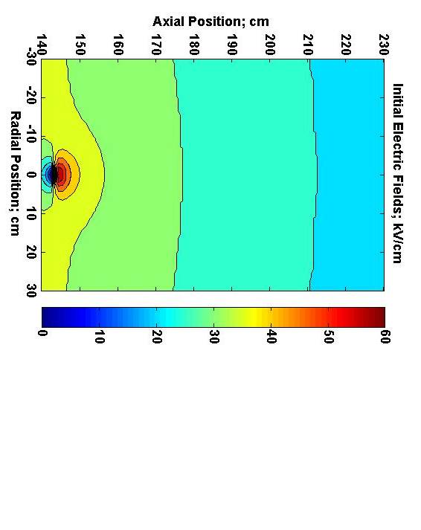

Slide 25
Charges collected on Insulating Windows
amplify background fields
e
e
e
Field E
Field E
Field zero
Field 2E

Slide 26
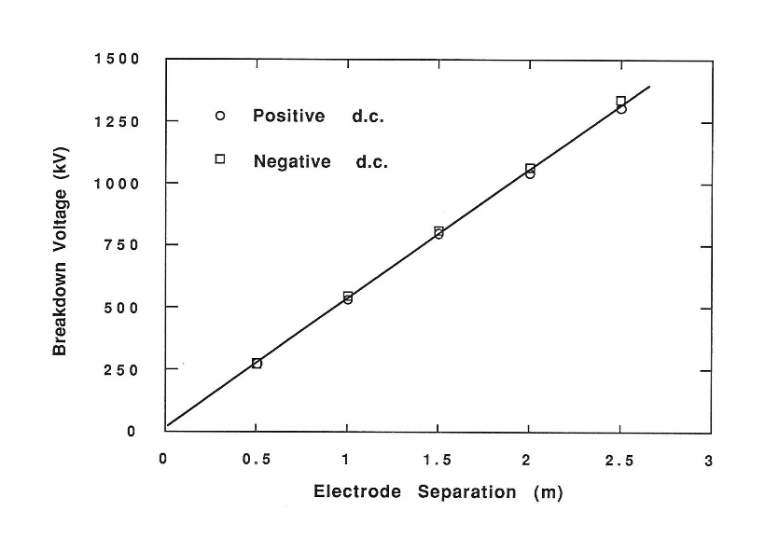
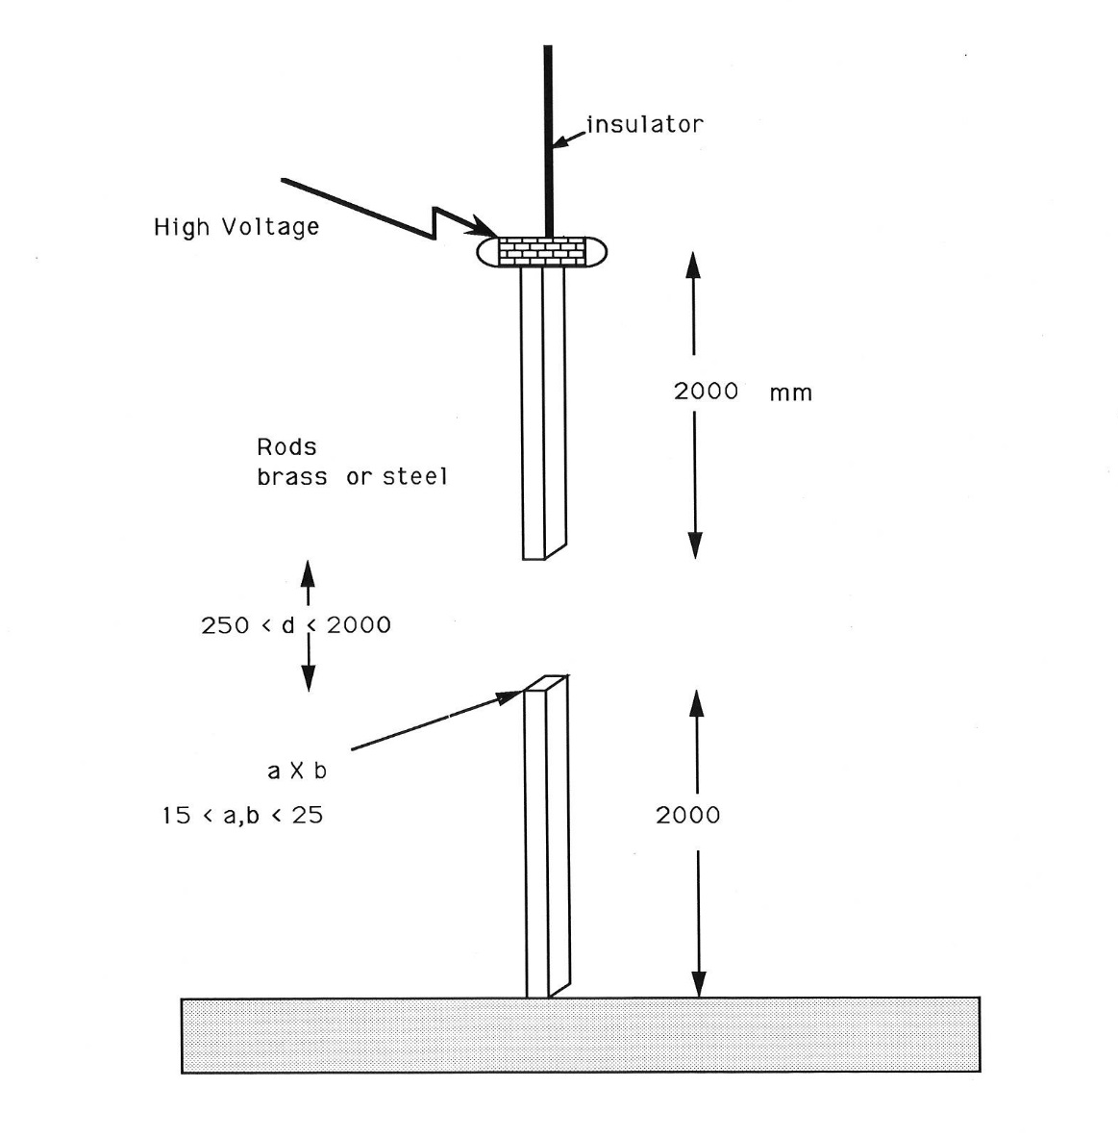

Slide 28
Equilibrium Particle Densities

Slide 29
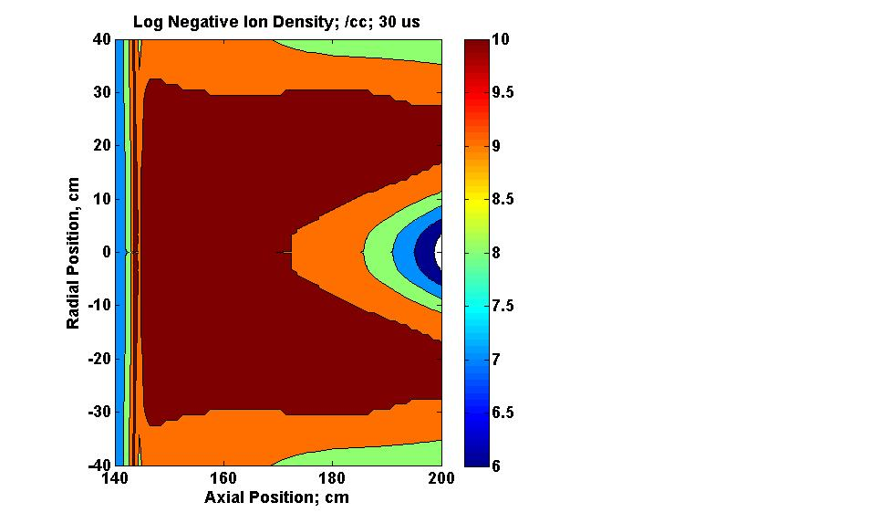
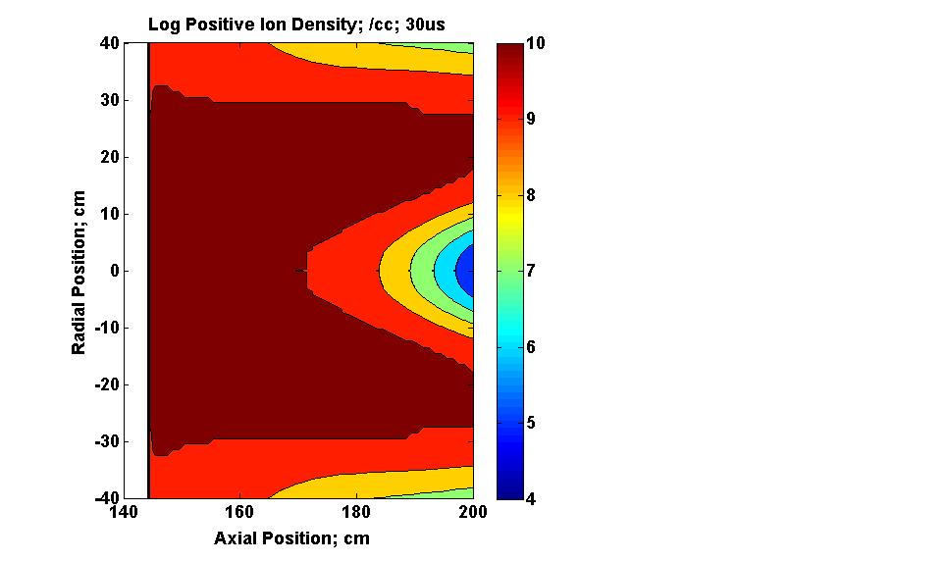
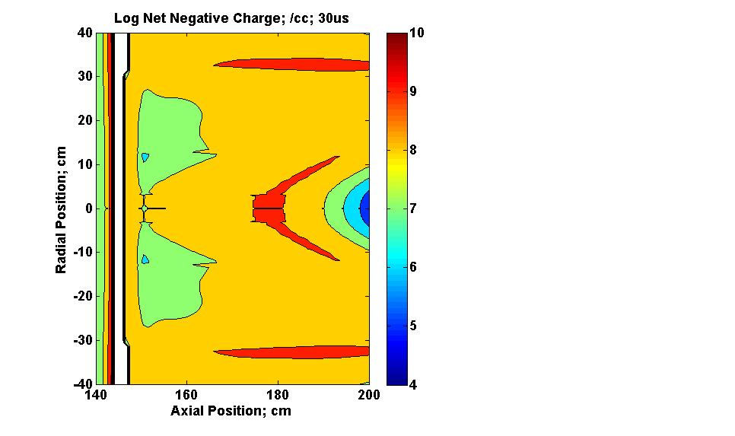
Particle Densities; 30 μs;
Negative Ions, Positive Ions and Net Negative Charge

Slide 30
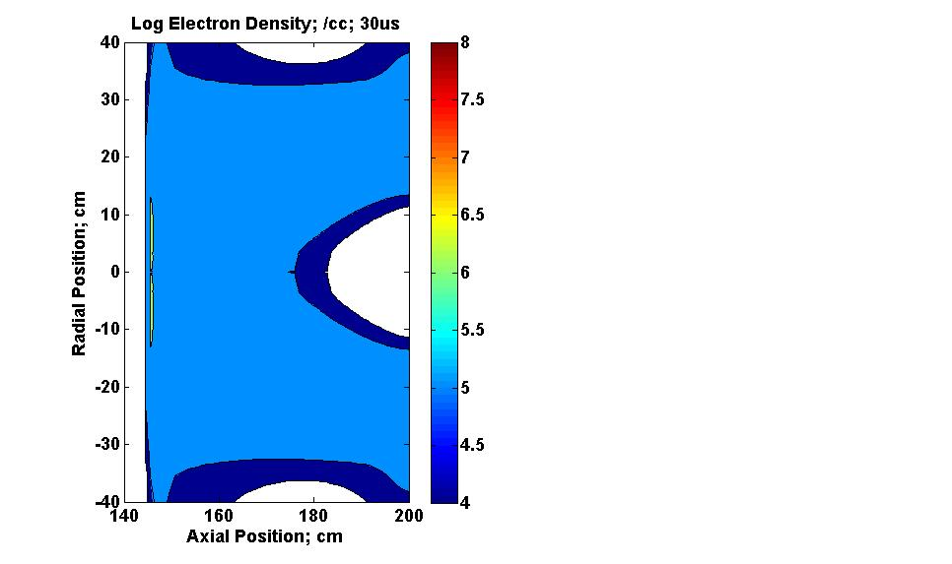
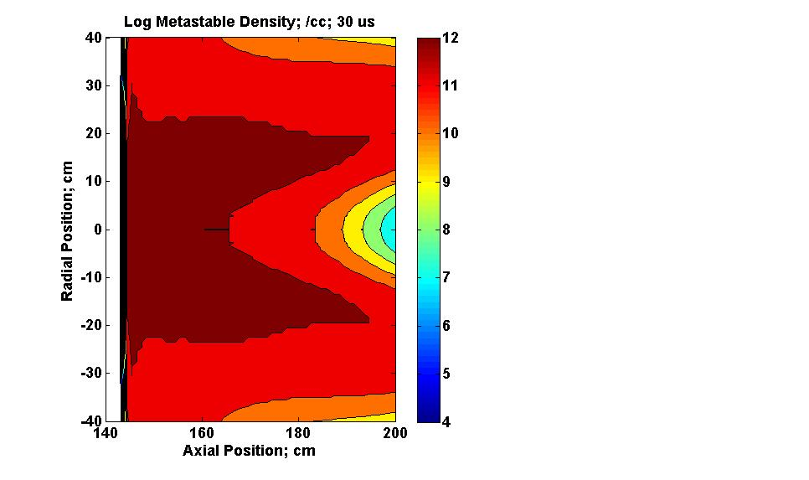
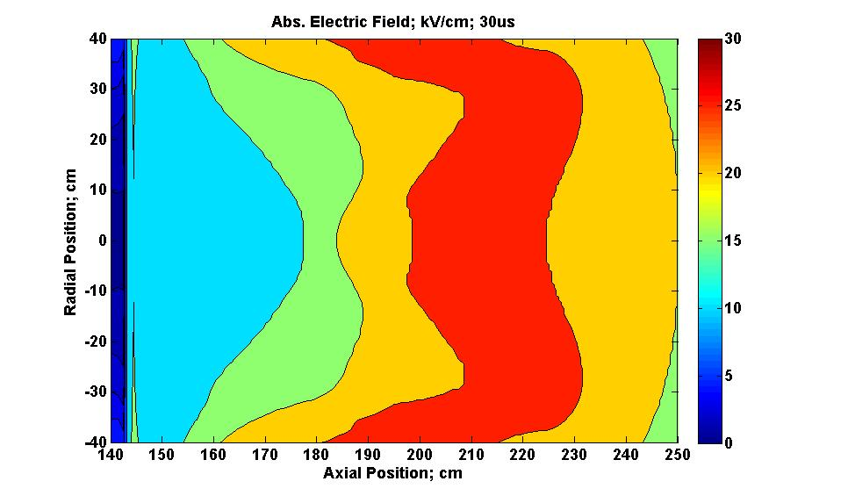
Electric Field; Electron Density; Metastable Density; 30 μs

Slide 32
Successive discharge pulses accumulate metastables
(1)
(2)
(3)
(4)
Outside
Inside
_
_
_
_
_
_
+
_
_
+
_
_
_
_
+
_
_
+
_
_
_
+
_
_
+
_
+
+
Window
Ionization
if E > 25
kV/cm
Ionization
Current Pulse
Negatives
Disperse
E < 25 kV/cm
Zero current
Positives
Disperse
E increases to (1)
Zero current

Slide 33
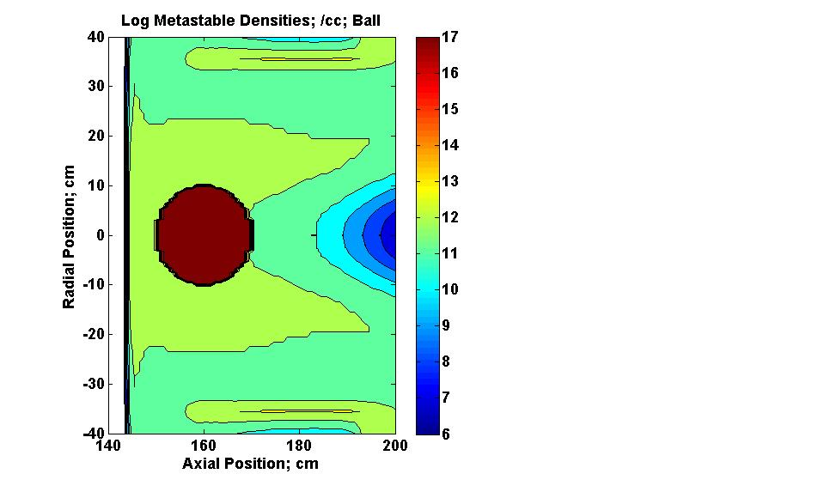
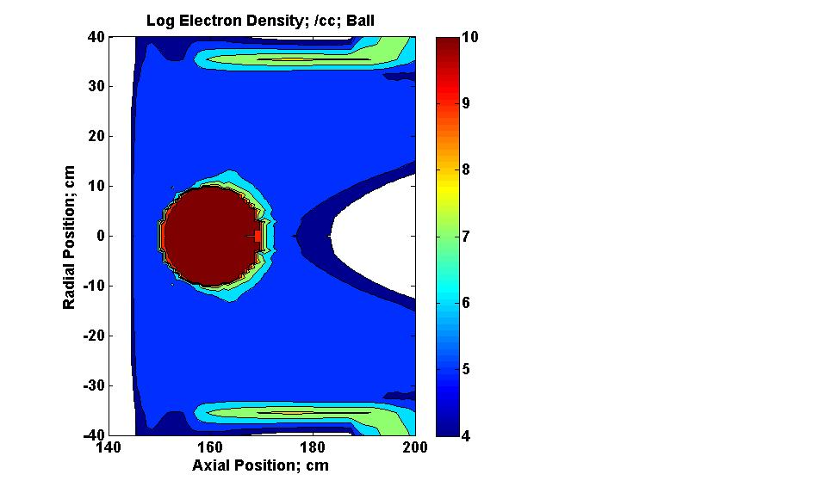

Slide 34
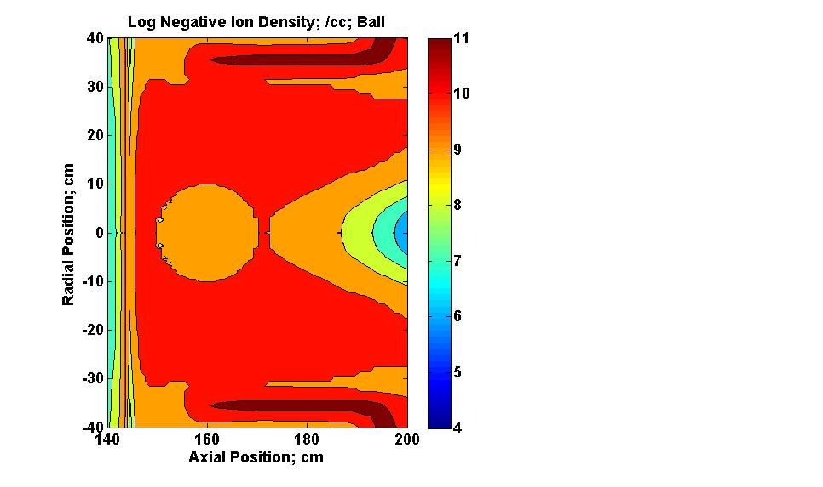
Particle Densities after accumulation of Metastables
Metastables, Electrons and Negative Ions

Slide 35
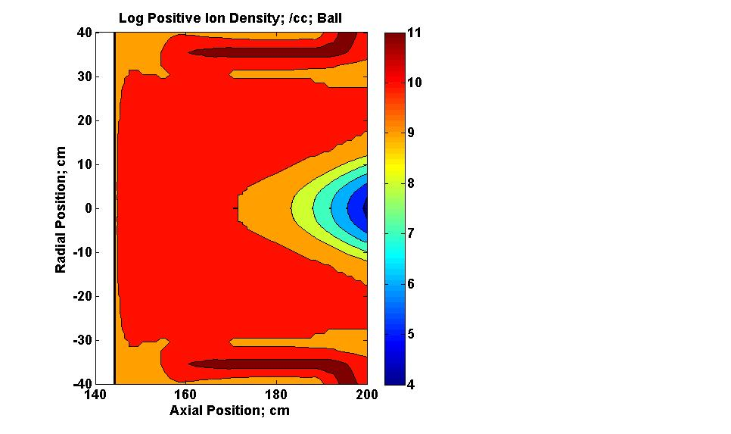
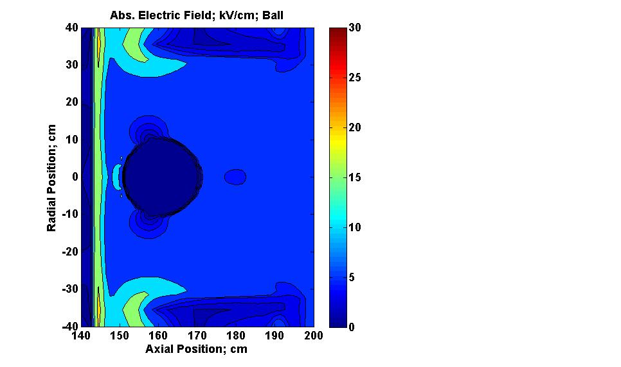
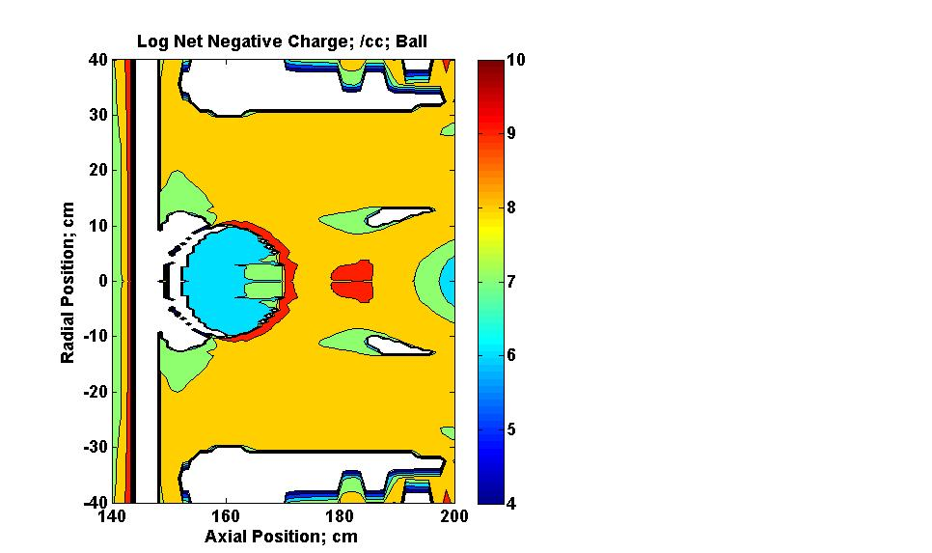
Electric Field after accumulation of Metastables

Slide 36
Thousands of Pulses
Equilibrium of electron attachment to form negative ions and
electron detachment from Negative Ions by metastables.
Negative Ion formation e + O₂ → O₂⁻
Detachment of Negative Ions O₂⁻ + O₂* → 2O₂ + e
∂n_{m}/∂t = n_{i} n_{m} k_{D} = n_{e} n_{o} k_{a}
= 1/ n_{i} k_{D} ~ 10 s for n_{i} = 10⁹ /cc
n_{e}/ n_{i} = n_{m} k_{D}/n_{o}k_{a} = 0.001 for n_{m} = 10¹²/cc
need n_{m} ~ 10¹⁷/cc for n_{e}/ n_{i} ~ 1

Slide 37
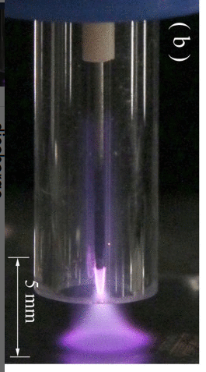
Curing Cancer
Plasma Discharge
1 bar
3W
7 kV
13.56 MHz
He + O₂
Applied Physics Letters >
Volume 97, Issue 15 >
10.1063/1.3496041

Slide 38
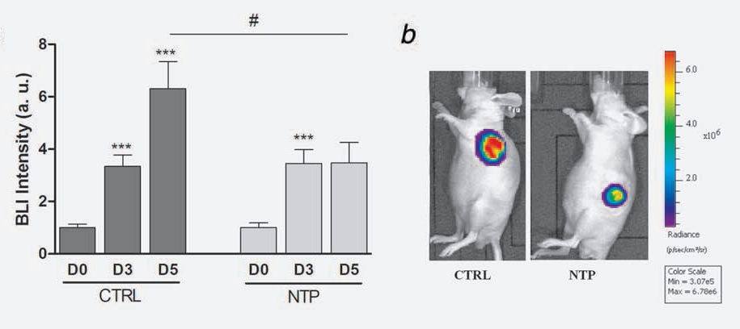
Non-Thermal Plasmas (NTP)
Reduce Cancer Tumors!
M. Vandema et al, Int. J. et Cancer, 130(9), 2185, 2012

Slide 39
Tumors in 5 mice
Plasma Sources Sci. Technol. 27 (2018) 01400

Slide 40
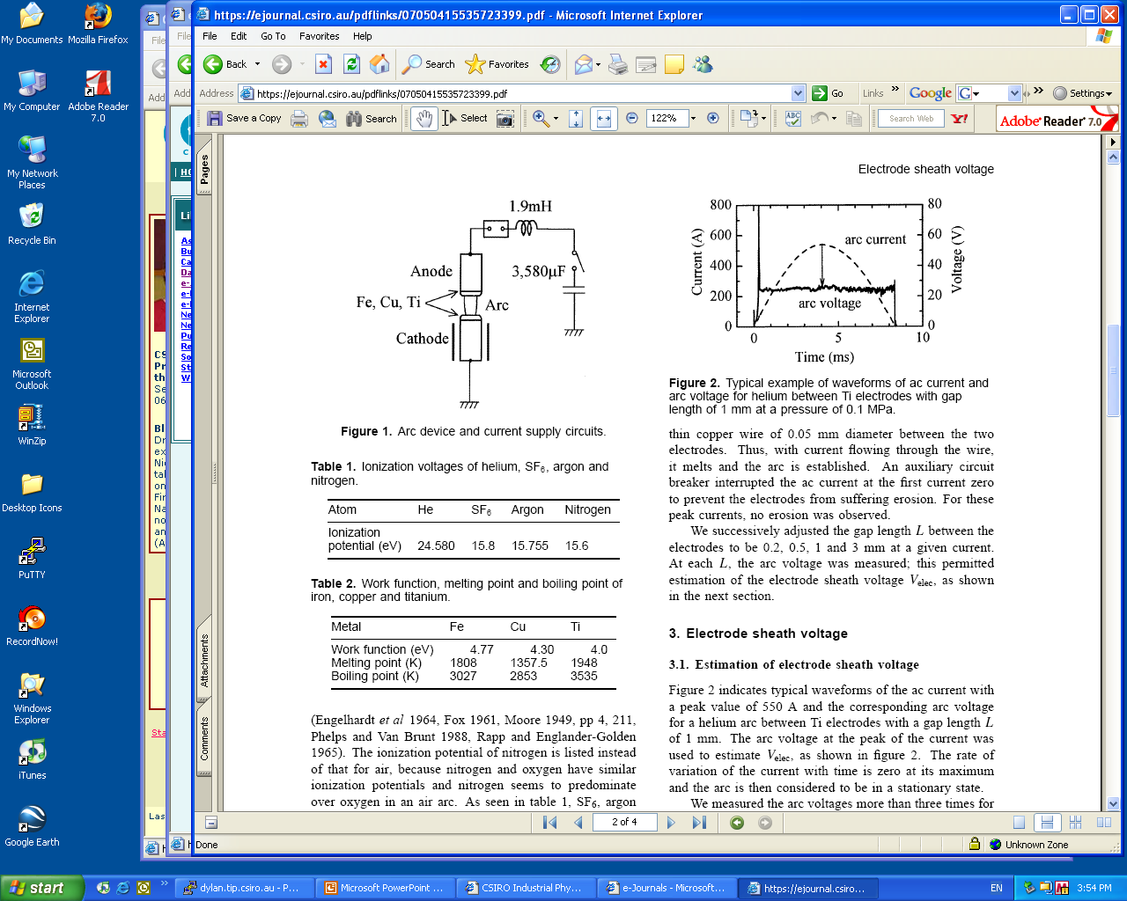

Slide 41
Microplasmas Sousa et al
Plasma Source Sc. and Tech.
22, 035012, 2013
1 mm hole
0.5 mm alumina separation plate
0.1 mm thick electrodes Mo; 1 kV
Microplasmas Sousa et al
Plasma Source Sc. and Tech.
22, 035012, 2013

Slide 42
Papers: 19 authors, 10 laboratories; 5 countries; 130 references
Plasma Sources Science and Technology 27 2018, 014001
Modelling the helium plasma jet delivery of
reactive species into a 3D cancer tumour
Endre J Szili1,2,11 , Jun-Seok Oh3,4,5,11 , Hideo Fukuhara6,11,12,
Rishabh Bhatia1,2, Nishtha Gaur1,2, Cuong K Nguyen1,2,7, Sung-Ha Hong1,2,
Satsuki Ito3, Kotaro Ogawa3, Chiaki Kawada6, Taro Shuin6,
Masayuki Tsuda8, Mutsuo Furihata9, Atsushi Kurabayashi9,
Hiroshi Furuta3,4, Masafumi Ito5, Keiji Inoue6, Akimitsu Hatta3,4,12 and
Robert D Short1,2,10,12
1 Future Industries Institute, University of South Australia, Adelaide, SA 5095, Australia
2 Wound Management Innovation Cooperative Research Centre, Australia
3 Department of Electronic & Photonic Systems Engineering, Kochi University of Technology, Kami,
Kochi 782-8502, Japan
4 Center for Nanotechnology, Research Institute of Kochi University of Technology, Kami, Kochi 782-
8502, Japan
5 Department of Electrical and Electronic Engineering, Meijo University, Naogya, 468-8502, Japan
6 Department of Urology, Kochi Medical School, Nankoku, Kochi, 783-8505, Japan
7 Faculty of Engineering Physics & Nanotechnology, Vietnam National University, 144 Xuan Thuy, Cau
Giay, Hanoi, Vietnam
8 Division of Laboratory Animal Science section of Life and Functional Materials, Kochi Medical School,
Nankoku, Kochi, 783-8505, Japan
9 Department of Pathology, Kochi Medical School, Kochi Medical School, Nankoku, Kochi, 783-8505, Japan
10 Materials Science Institute and Department of Chemistry, The University of Lancaster, City of Lancaster
LA1 4YW, United Kingdom
E-mail: fukuhara@kochi-u.ac.jp, hatta.akimitsu@kochi-tech.ac.jp and r.d.short1@lancaster.ac.uk
Received 4 September 2017, revised 14 November 2017
Accepted for publication 17 November 2017
Published 8 December 2017
42 |
Presentation title | Presenter name

Slide 43
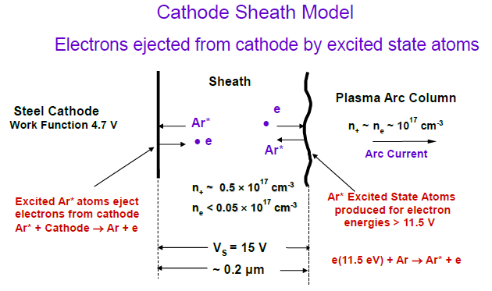

Slide 44
